Slide 1

UR-CODE-LITE

Slide 2
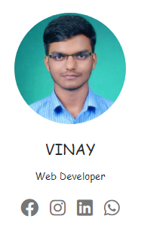
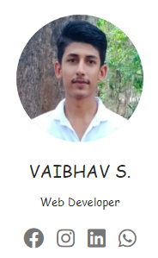
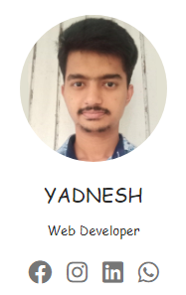
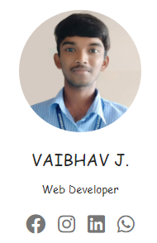
Hello!
Here’s Our Team

Slide 3


Slide 4


Slide 5
ABOUT PHP & MySQL
PHP Conditional Statements
In PHP we have the following conditional statements:
if statement - executes some code if one condition is true
if...else statement - executes some code if a condition is true and another code if that condition is false
if...elseif...else statement - executes different codes for more than two conditions

Slide 6

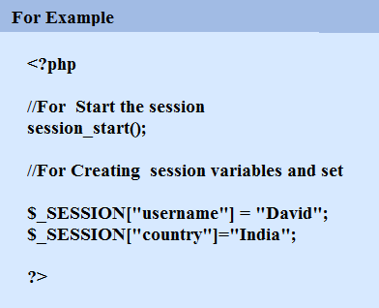

Slide 7


Slide 8
ABOUT PHP & MySQL
PHP Upload Files
$_FILES - HTTP File Upload variables supports(PHP 4 , 5, 7, 8)
An associative array of items uploaded to the current script via the HTTP POST method.
move_uploaded_file ( string $from , string $to ) : bool
This function checks to ensure that the file designated by $from is a valid upload. If the file is valid, it will be moved to the filename given by $to.

Slide 9


Slide 10
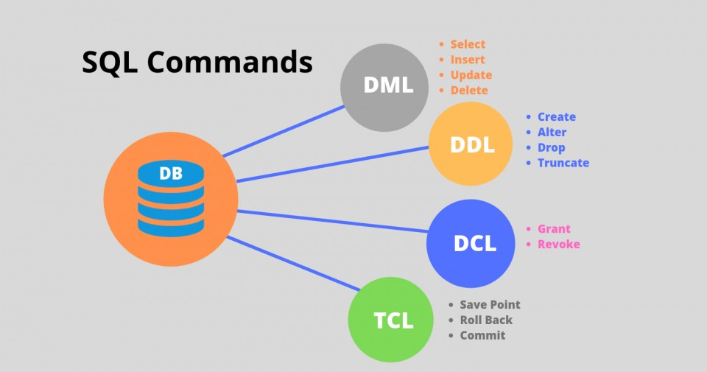

Slide 11
UR-CODE-LITE

Slide 12
OUR CONCEPT
The motivation of the project is from GitHub software. As we all know the GitHub software is to make the open-source project upload and visit.
The same though is presented in the our ur-code project but it is specifically developed for institute level, for the student belonging the same institute so they can easily get ideas of projects, format of report generation and easily submit their project softcopies to the faculty.

Slide 13
INSTRUCTIONS FOR USE
Replace This Values In XAMPP's ‘php.ini’.
post_max_size=1024M.
file_uploads=On
upload_max_filesize=1024M
max_file_uploads=100
Replace This Values In XAMPP's 'httpd-xampp.conf'.
Replace 'Require all denied' to 'Require all granted' for access in LAN.
Note: Only Select '.zip' Extension File While Uploading Compressed Version.

Slide 14
OUR OBJECTIVES
Make the project easily available for the students by the students.
Reduce the time wastage and the stress of faculty to collect the projects.
It will build confidence and presentability of students

Slide 15
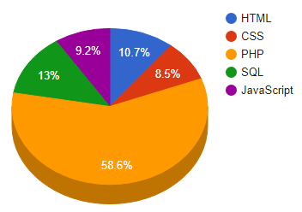
Technologies Which We are Used

Slide 16
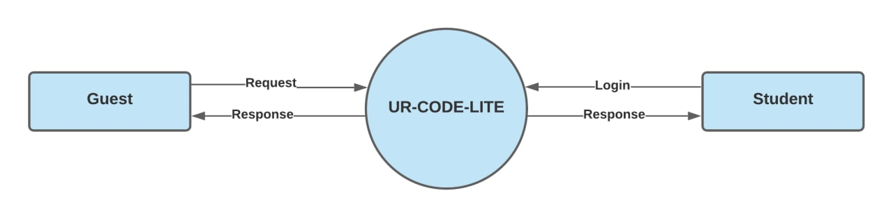
DFD LEVEL 0

Slide 17
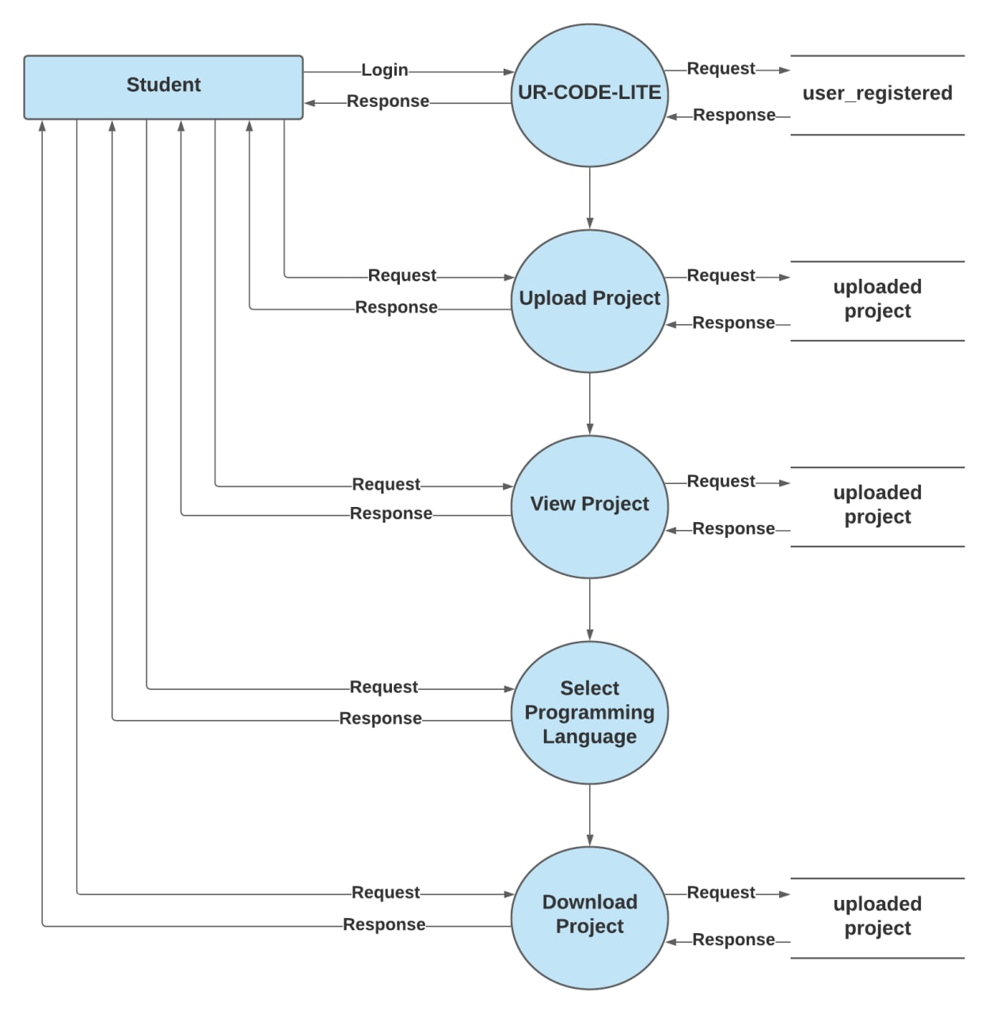
DFD LEVEL 1

Slide 18
Our Projects Pages/Outputs

Slide 19



Technologies that's makes our project portable

Slide 20
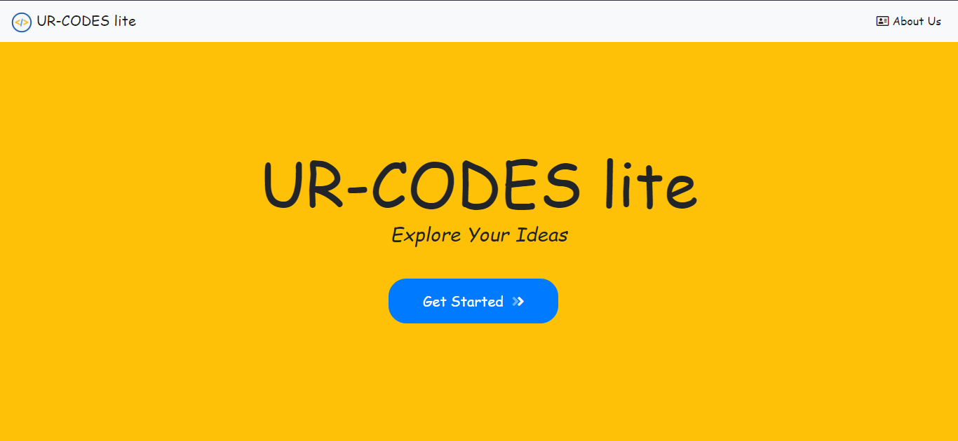
HOME PAGE

Slide 21
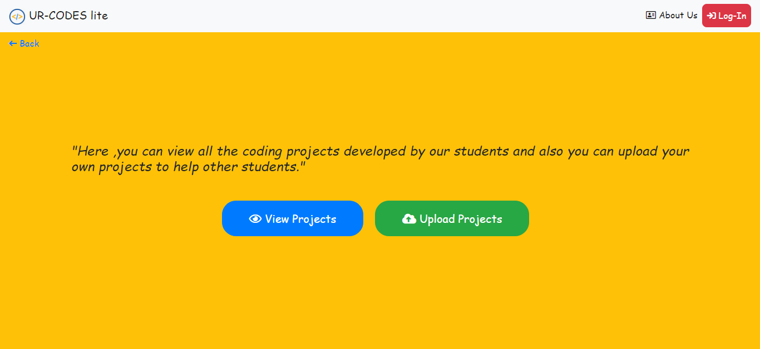
MAIN PAGE

Slide 22
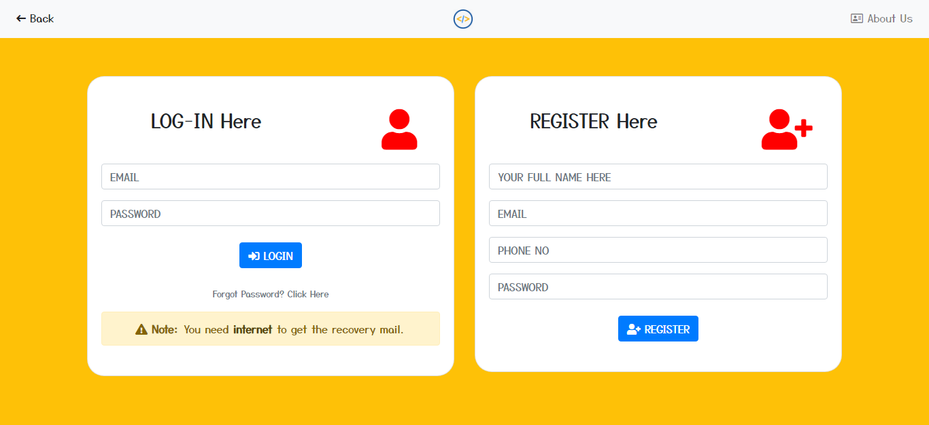
LOGIN / REGISTER PAGE

Slide 23
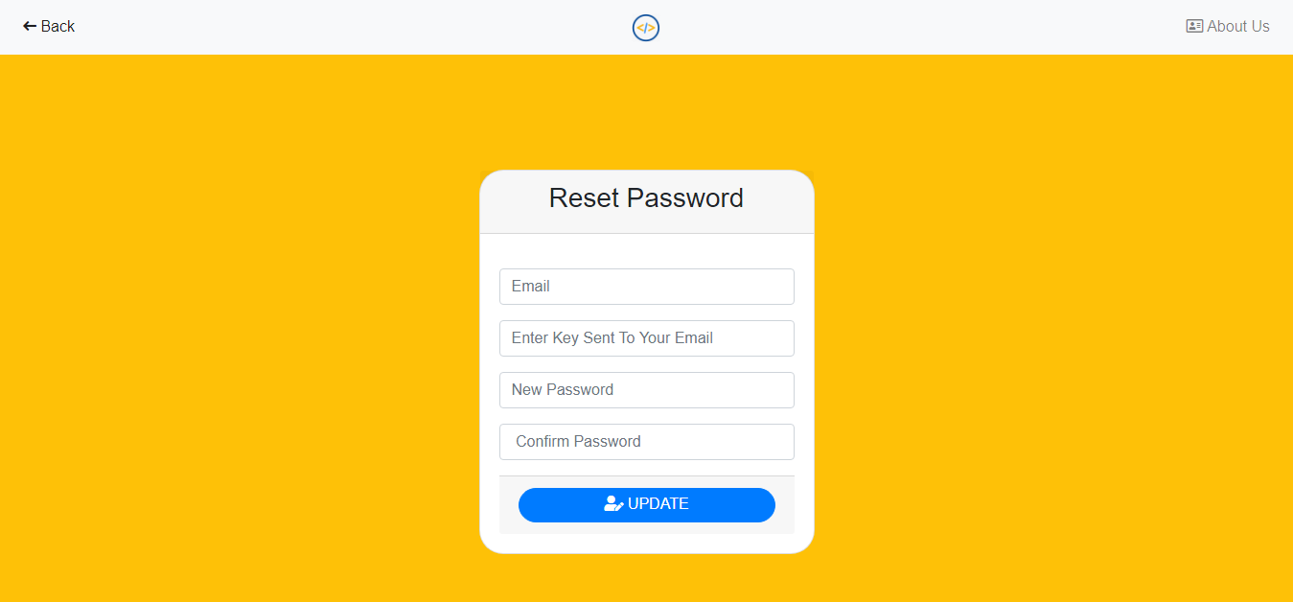
RESET PASSWORD PAGE

Slide 24
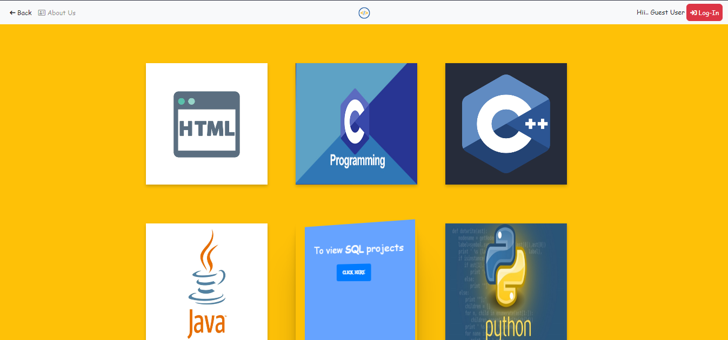
VIEW TOPICS PAGE

Slide 25
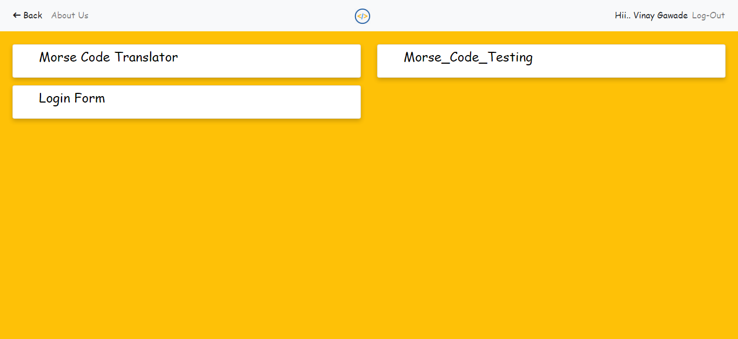
VIEW PAGE

Slide 26
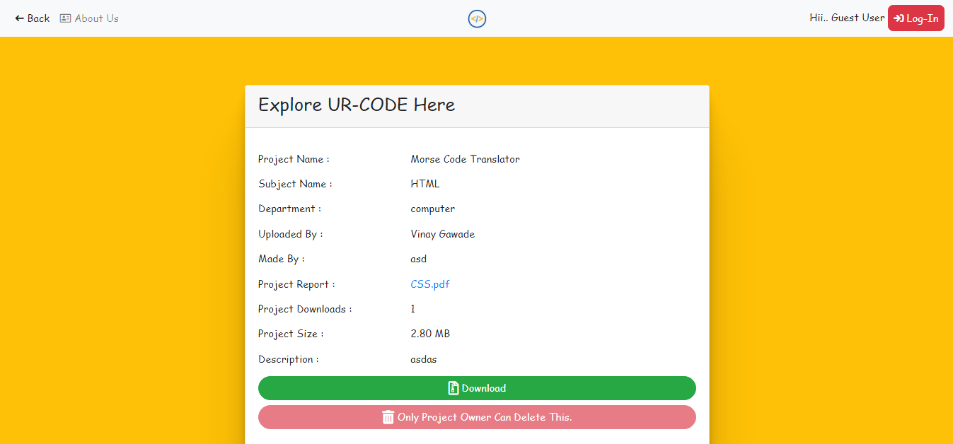
OPEN PROJECT PAGE

Slide 27
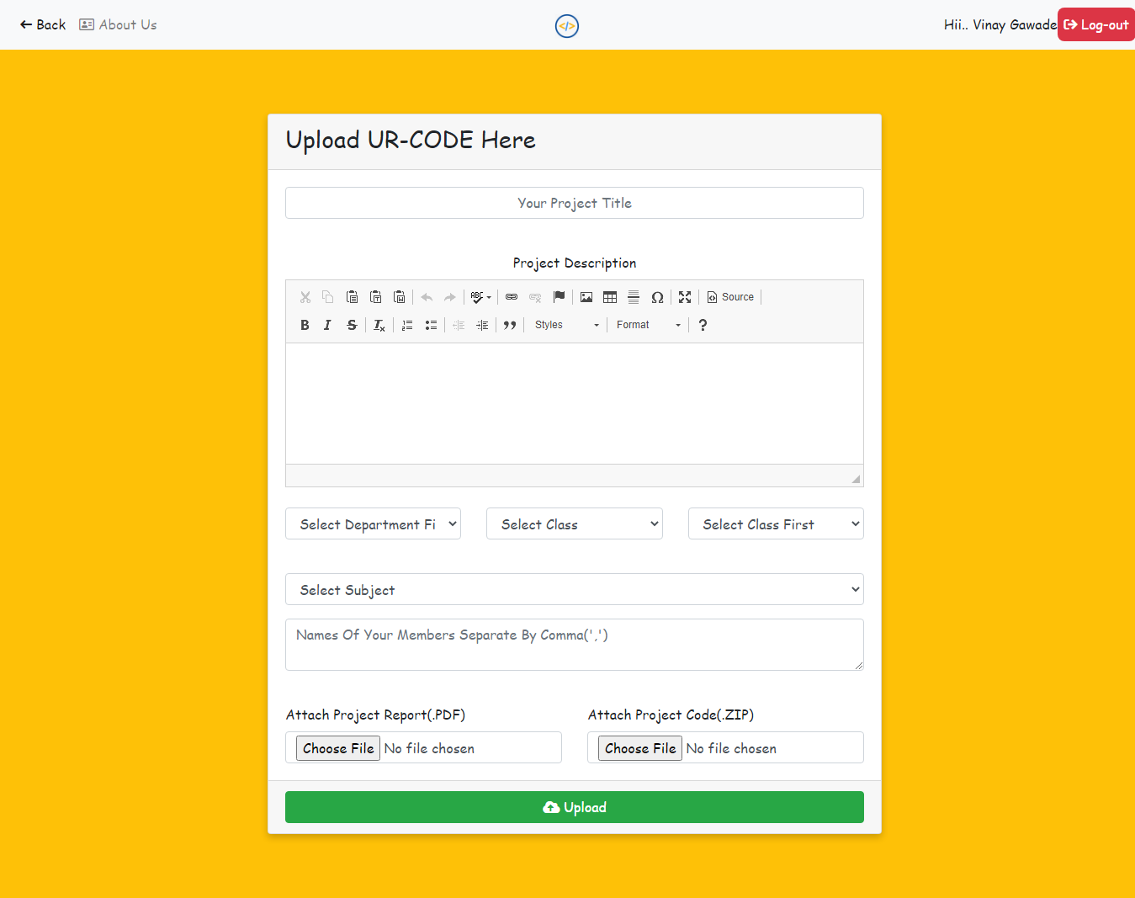
UPLOAD PAGE

Slide 28
Thanks You!
Any questions?
You can find we at:
@Yashwantrao_Bhonsale_Polytechnic

